Slide 1


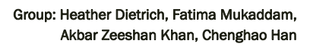

Slide 2
MOTIVATION & SUMMARY
OBJECTIVE
• Visualize the impact of COVID 19 on the world with an emphasis on North America
QUESTIONS
How has COVID-19 impacted the provinces in Canada (cases, deaths, and vaccine admin)?
How has COVID 19 impacted countries of the world (cases, deaths)?
Does COVID-19 impact technology stocks? Is there a relationship between COVID-19 news events and the performance of technology stocks ?
SUMMARY
We were able to create visualizations for all our questions to our satisfaction
Canadian COVID cases focus within Ontario and Quebec and globally, the US has the most significant number of cases.
The technology industry has been positively impact by COVID-19

Slide 3




DATA SOURCES

Slide 4
DATA CLEANUP AND EXPLORATION
Data was extracted using SQLAlchemy from ElephantSQL database and output in json format to Flask app route
Visualizations were created in javascript pulling input data from Flask app route and outputs were sent to HTML
Dashboard page was formatted using HTML and CSS
App was deployed to Heroku through GitHub

Slide 5
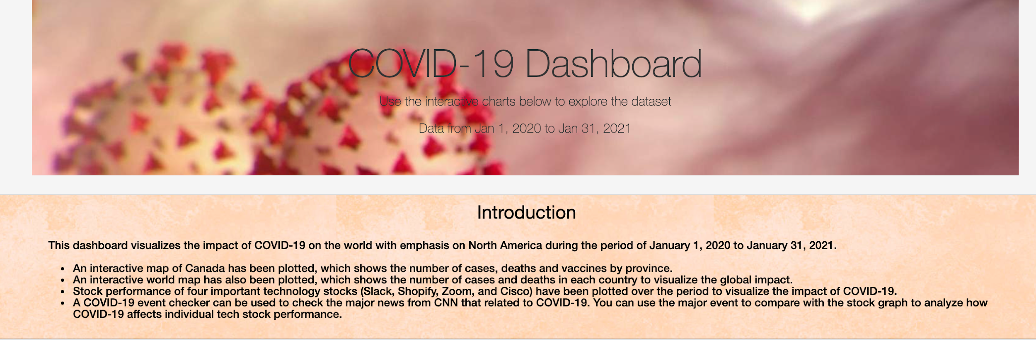
DASHBOARD

Slide 6
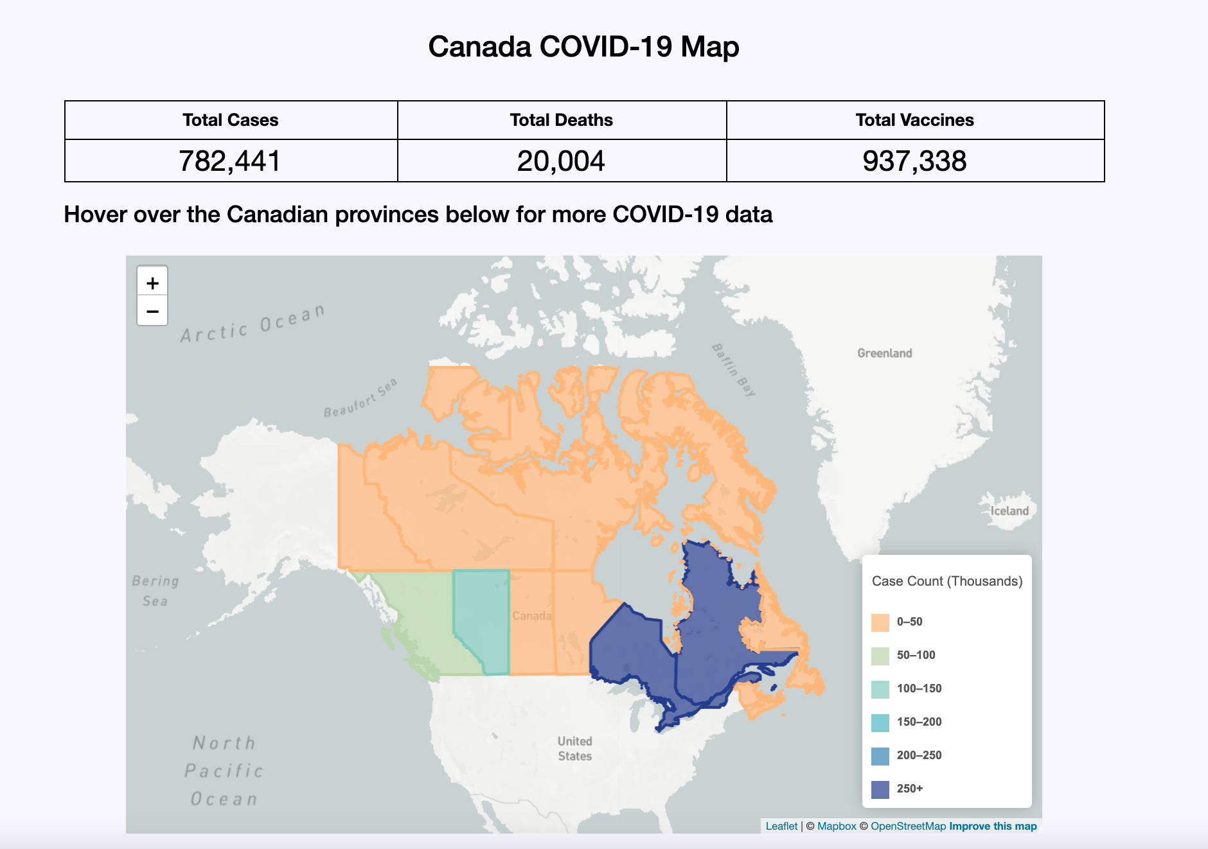
VISUALIZATIONS
MAP OF CANADA
Cases
Deaths
Vaccines

Slide 7
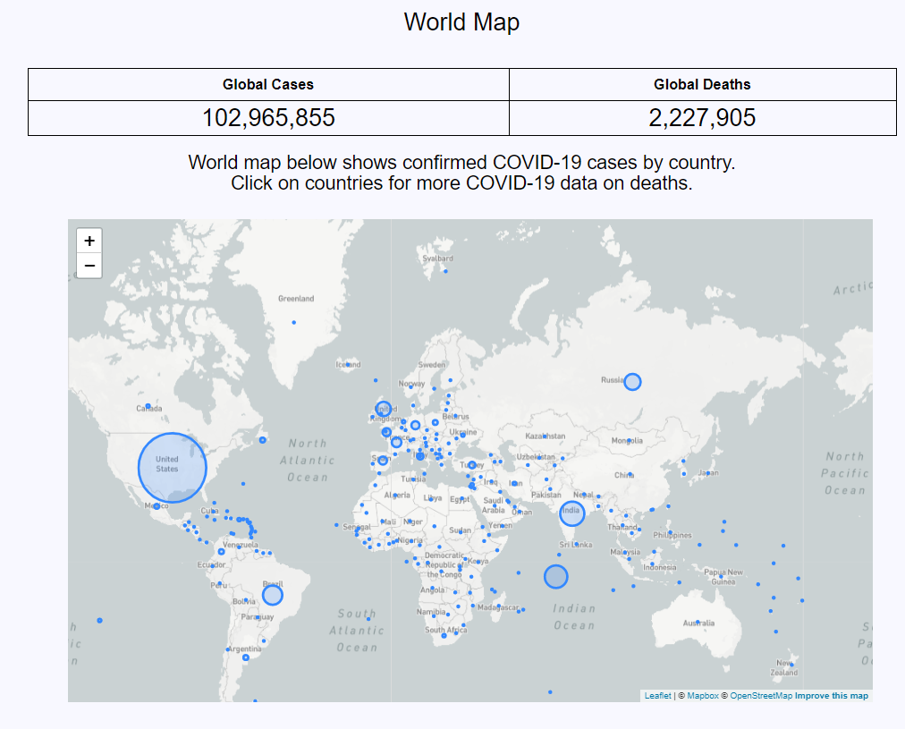
VISUALIZATIONS
World Map
Cases
Deaths

Slide 8
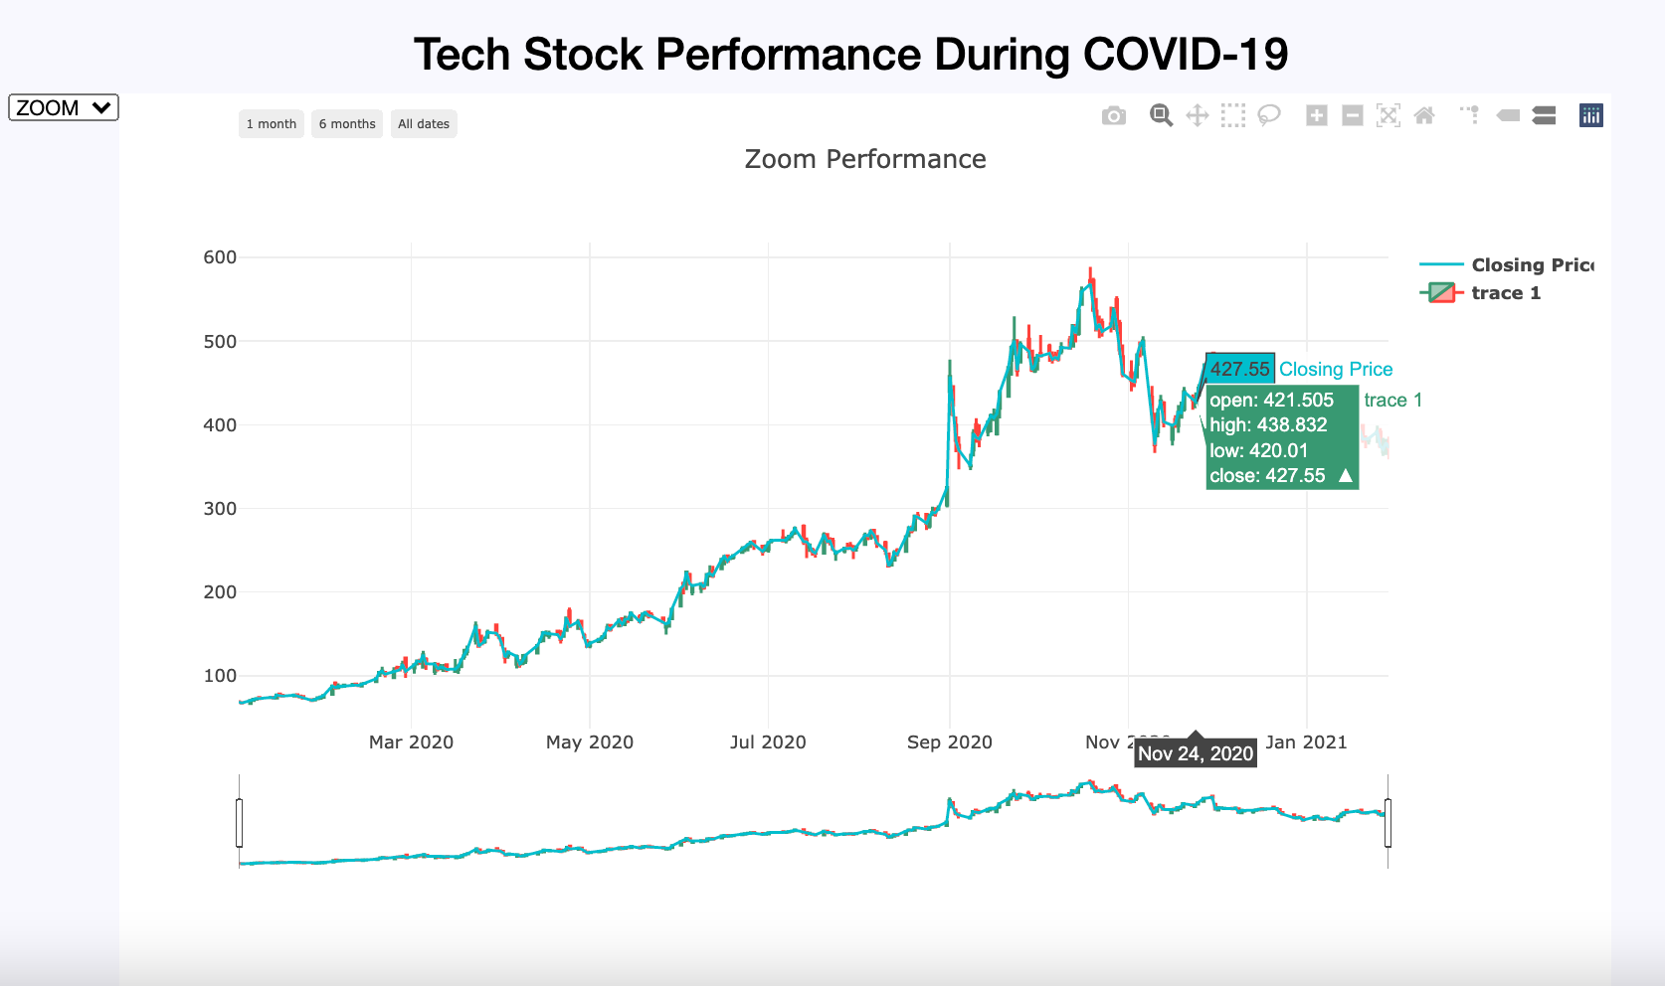
VISUALIZATIONS
STOCK PRICES (Technology Stocks)
Drop down for each stock

Slide 9
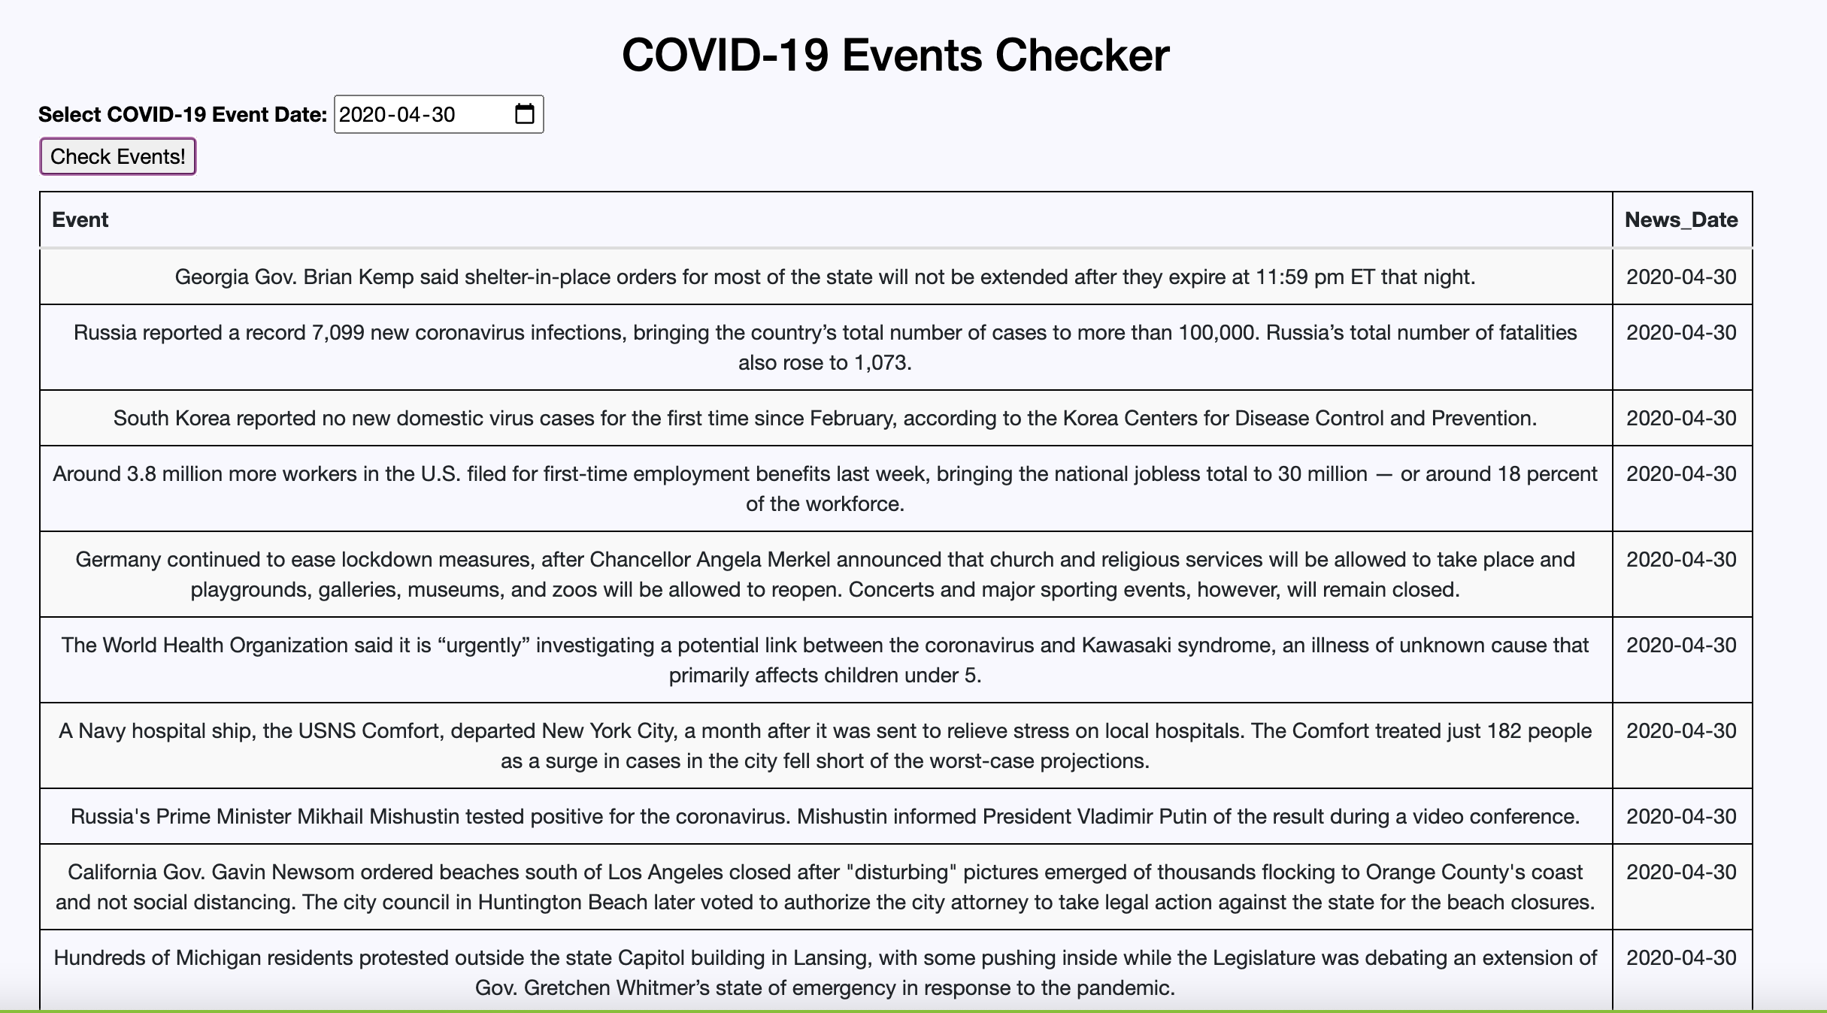
VISUALIZATIONS
Major COVID-19 news events finder

Slide 10
Discussion
COVID has a severe impact at the global level and national level
Vaccine rollouts have started in many countries, including Canada.
The provinces of Ontario and Quebec are leading vaccine administration within Canada
US and India leading the case and death count globally
Significant news events related to COVID-19 impacted all the countries around the world and various companies (including technology)
Technology stocks have seen a spike as work from home and virtual classes have become the latest trend throughout the world

Slide 11
Post Mortem
Make our data live instead of it being static as of a specific page
Enhance the dashboard with advanced HTML tags and formatting
Make the application more interactive with new data and new insights
Make our visualization more responsive using media queries
To have navigation bars to link to each visualization to assist in navigating the web page
Allow the visitor access to the data showed in the visualizations
Notes:
Make our data life instead of it being static as of a specific date

Slide 12

Questions

